Slide 1









IMPLEMENTATION of a SIMPLE DTD FOR AN ONLINE STORE
PRESENTED BY GROUP 6

Slide 2
CONTENT
01
INTRODUCTION
02
STUDY
03
DTD IMPLEMENTATION
04
CONCLUSION

Slide 3

INTRODUCTION
The is the analysis of current state of the online store's product catalog, focusing on its structure, data elements, and potential improvements. The report utilizes a Document Type Definition (DTD) as a foundational framework for data organization.
A DTD (Document Type Definition) defines the structure and data elements for your product catalog. This ensures consistency, improves search, and facilitates data exchange with other systems

Slide 4
STUDY
CURRENT PRODUCT CATALOG STRUCTURE
Root Element: <catalog> - This element serves as the container for all product data within the catalog.
Product Element: <product> - Represents an individual product within the catalog. Each product element contains child elements with specific data points.
<id>: Unique identifier for the product (e.g., number).
<name>: Product name (e.g., T-Shirt).
<category>: Category the product belongs to (e.g., Clothing).
<price>: Product price (e.g., 19.99).

Slide 5
STUDY
DATA ANALYSIS
Data Enrichment
Data Hierarchy
Inventory Management

Slide 6


Slide 7
STUDY
ADVANTAGES OF DTD-BASED APPROACH
Data Validation
Improved Search and Filtering
Scalability
Data Exchange

Slide 8

CASE STUDY: AMAZON
Implement a Document Type Definition (DTD)
Defines a consistent structure for product data.
Improves search & filtering for a better customer experience.
Enables easier data exchange and future integrations.
Benefits:
Increased sales through better product discovery.
Enhanced customer satisfaction with clear product information.
Scalable foundation for future growth.

Slide 9
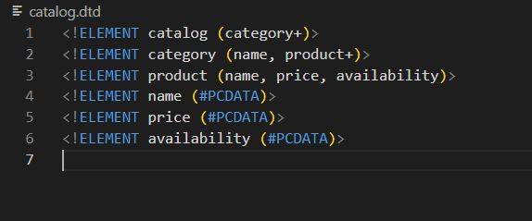
IMPLEMENTATION

Slide 10
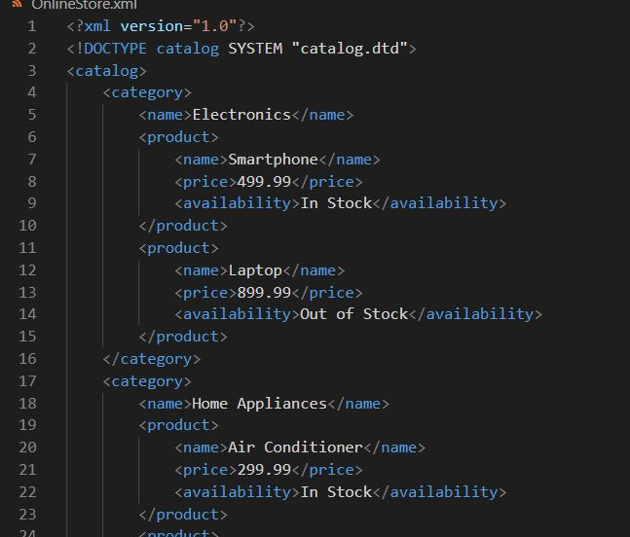
IMPLEMENTATION

Slide 11
CONCLUSION
Implementing a DTD for the product catalog can significantly improve its organization, maintainability, and functionality. This report provides a framework for optimizing the product catalog and enhancing the overall customer experience within the online store.

Slide 12


THANKS!

